Slide 1

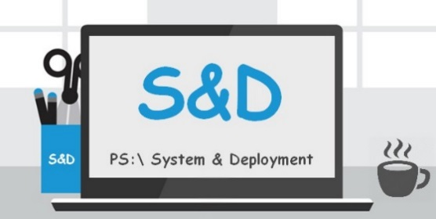
How to build Metro Design GUI with PowerShell
Damien VAN ROBAEYS

Slide 2
About me ?
System Engineer at Saint-Gobain
MVP Microsoft
Twitter: @syst_and_deploy
Blog: http://www.systanddeploy.com
Mail: damien.vanrobaeys@gmail.com

Slide 3
Summary
Forms ? WPF ?
Forms VS WPF
Start with WPF
Controls & Actions
XAML ?
XAML, ca ressemble à quoi ?
Création d’une interface
Lier PowerShell au XAML
Actions sur nos Controls
Habiller vos GUI avec un thème
Why WPF ?
Understand WPF

Slide 4
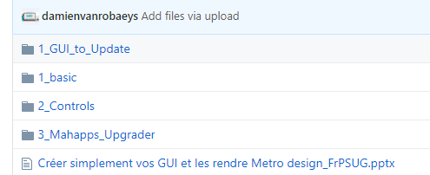
GitHub Repository
All samples are located in the link below
https://github.com/damienvanrobaeys/WPF_PS_EN

Slide 5
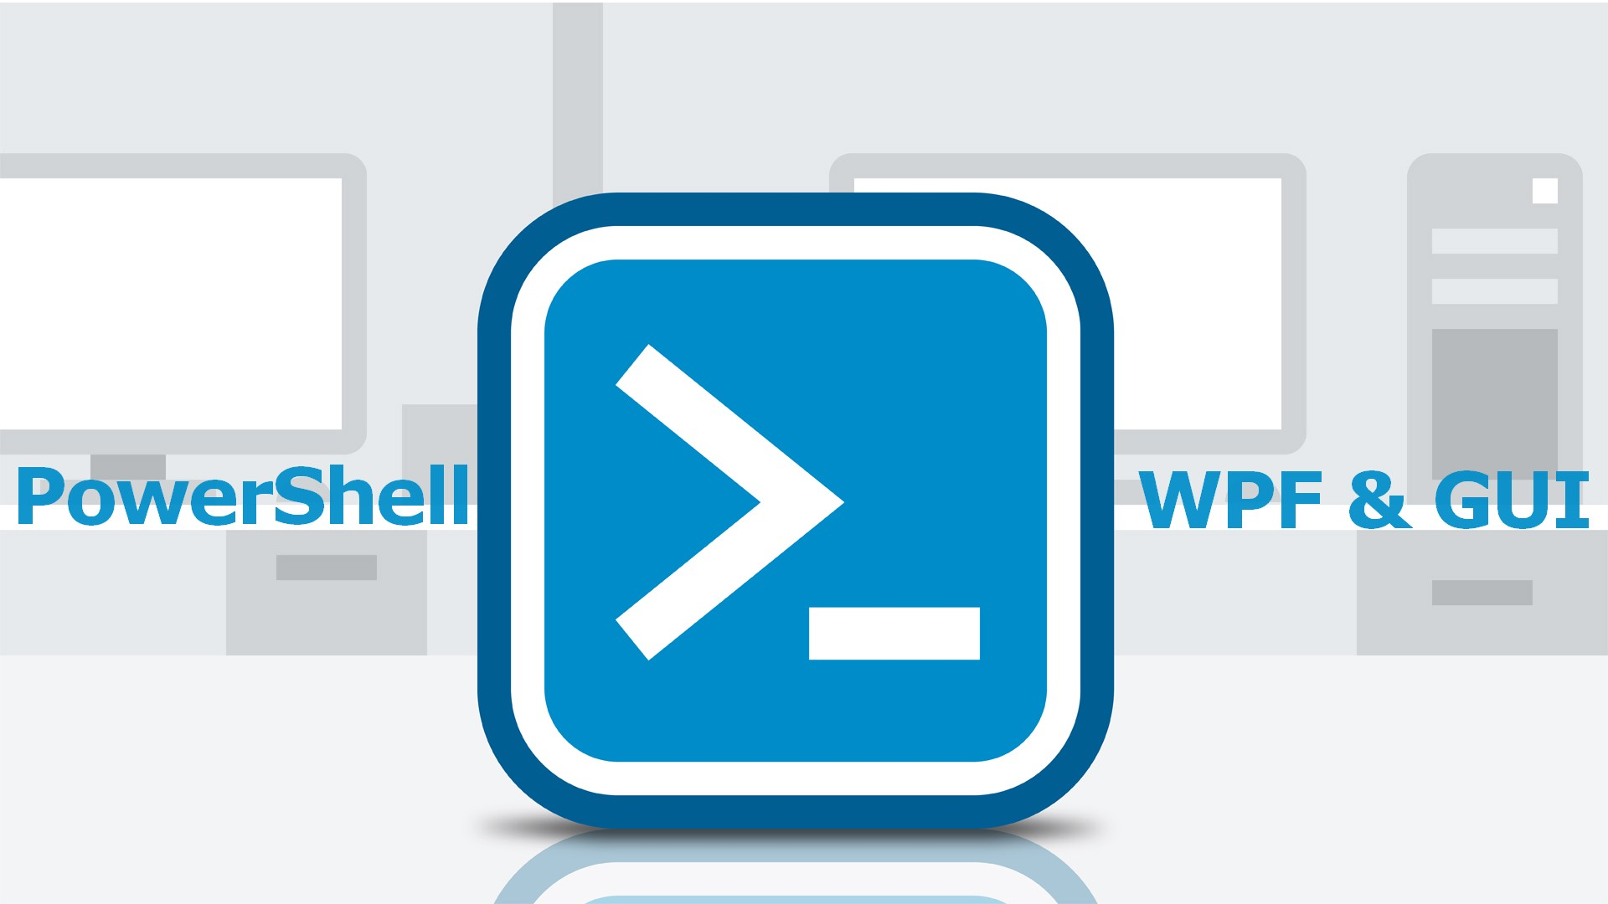
PowerShell GUI & WPF
Join the PowerShell GUI & WPF Facebook Group
https://www.facebook.com/groups/PowershellGUI/
Share knowledge
Share your GUI
Ask for help
Share links
…

Slide 6
Forms ? What is it ?
Name of the Graphical Class library included as a part of .NET Framework
Allows to create easily GUI
Can be used with software like PrimalForm, PowerShell Studio…
Since Net Framework 3.0 (2006) ➔ « replaced » by WPF

Slide 7
WPF ? WTF ?
Windows Presentation Foundation
Since Framework 3.0 (2006)
Used to create GUI like forms
Uses the XAML language, based on XML

Slide 8


Why you should use WPF ?
WPF is easier to read
WPF is easier to create
WPF is easier to maintain
Fewer lines
Can add themes

Slide 9
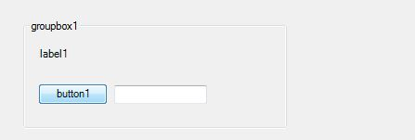
Forms vs WPF
See the below GUI using Forms then WPF
This GUI is composed of:
1 GroupBox
1 label
1 button
1 TextBox

Slide 10
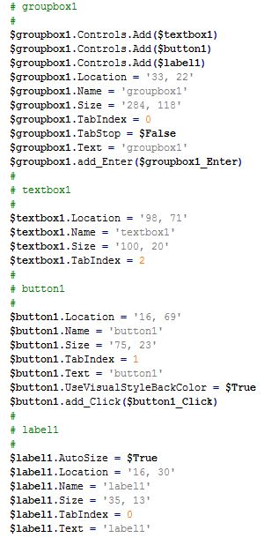
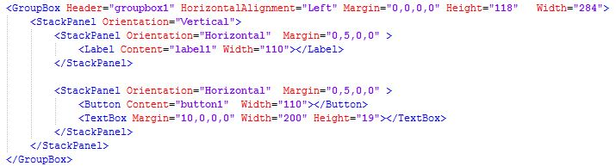

Forms VS WPF: Round 2
Line count: 27 vs 11

Slide 11
Understanding theWPF
Can be used with Visual Studio, Microsoft Blend…
Uses the XAML language
Can be used with one XAML/PS1 or all included in one PS1

Slide 12
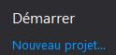
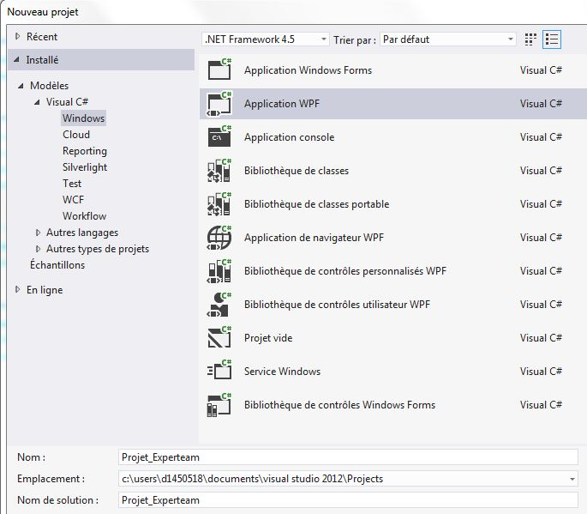
Start with WPF
In Visual Studio, create a new project
Choose WPF Application

Slide 13
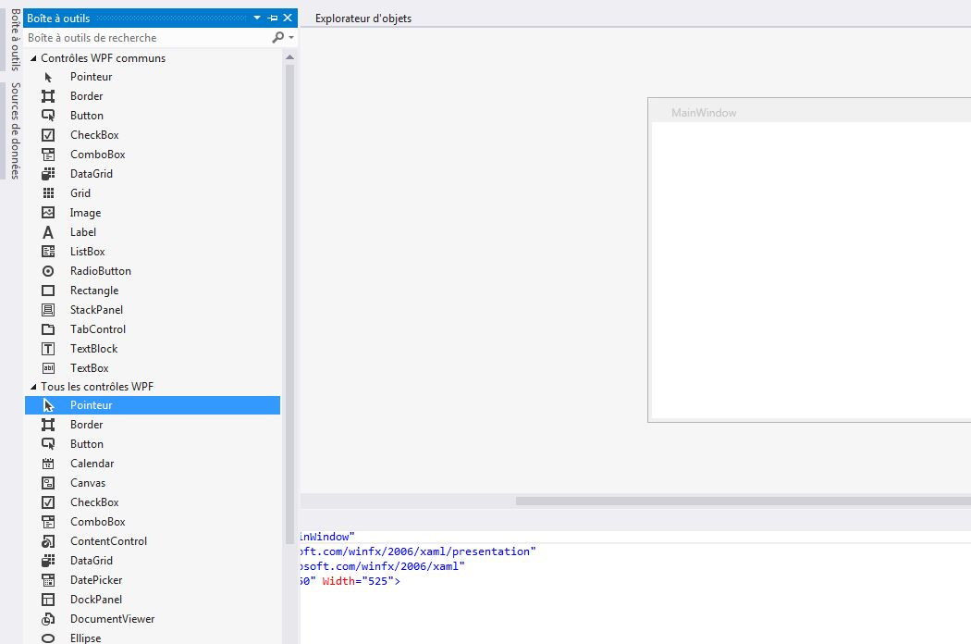
Visual Studio ?
Tools Box
1
2
Design part
XAML part
3

Slide 14
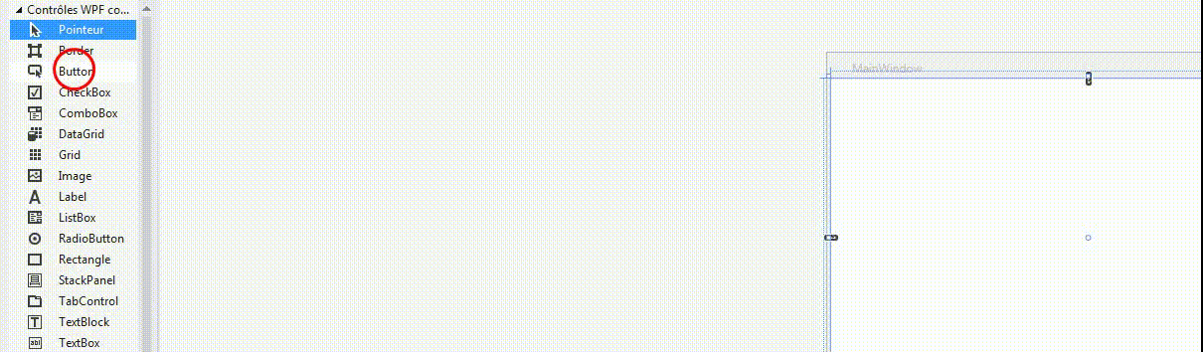
How to add controls ?
Move the control from the toolbox to the design part
The control will be displayed in the XAML part

Slide 15
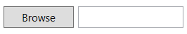
XAML ? What is it ?
Extensible Application Markup Language
Is prononced zammel
XAML is used to display the graphic part
Works with tag, like <button></button>
Works with attributes attributs

Slide 16
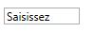
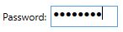
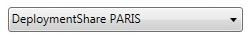
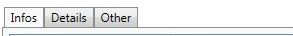
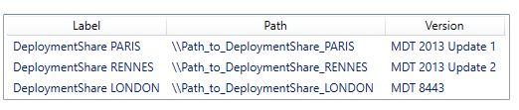
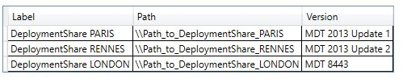
Controls in XAML
Display Control: Label, DataGrid, ListView …
Input Control: TextBox, PasswordBox
Choice Control: RadioButton, CheckBox, ComboBox
Navigation control: TabControl
Simple action control: Button

Slide 17
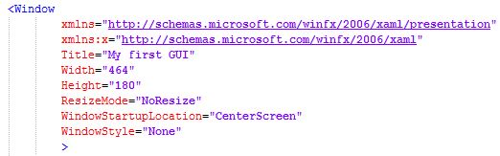
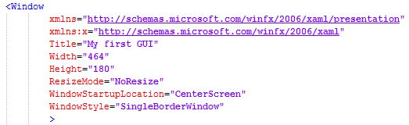
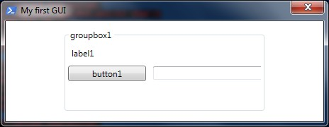
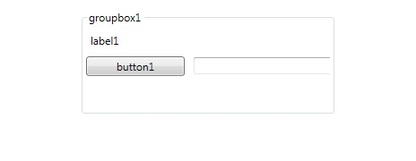
Modify the Window
The main Window can be customized, like with HTA
Set the GUI at the center ➔ WindowStartupLocation="CenterScreen«
Border modification➔ WindowStyle

Slide 18
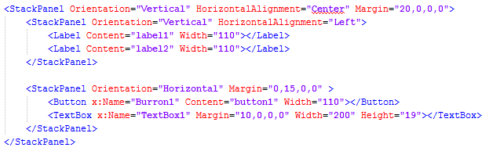
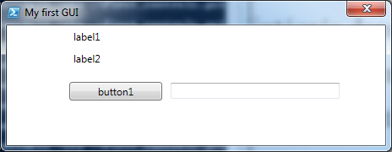
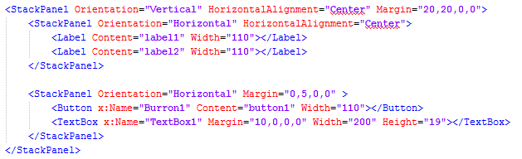
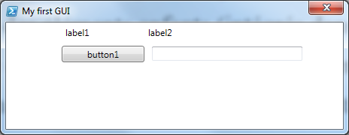
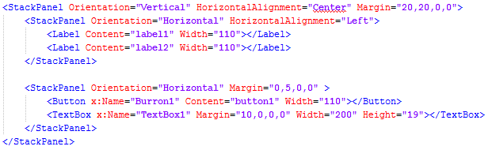
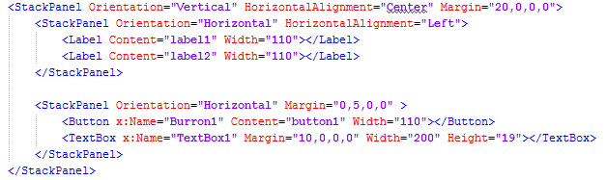
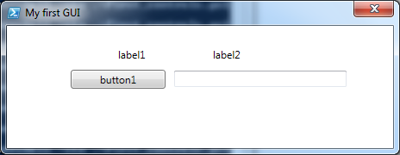
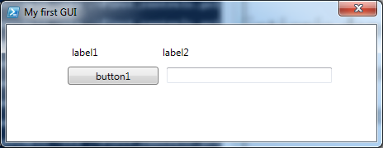
StackPanel ? What is it ?
Gather « child » controls, integrated in the StackPanel
Allows you to change quickly the orientation of multiple controls: Horizontal or Vertical
No need to add position of the control in the GUI

Slide 19
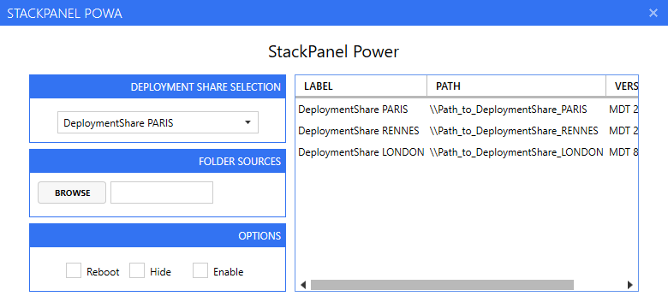
StackPanel: again & again
Play with Vertical & Horizontal
One main StackPanel
One Horizontal
Two Vertical

Slide 20
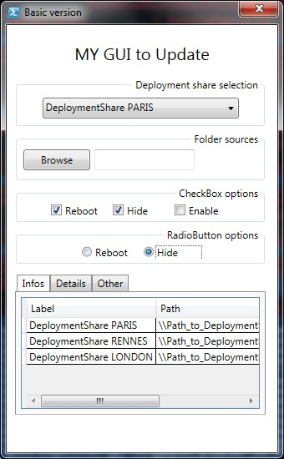
Let’s create a first simple GUI
Add a ComboBox
A button with a TextBox
Add 3 CheckBox
Add 2 RadioButtons
One TabControl
A DataGrid

Slide 21
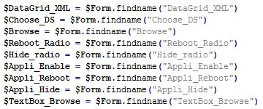
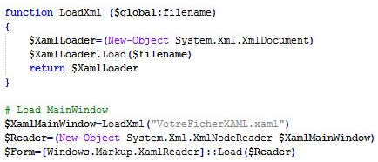
Mapped XAML and PS1
Load the XAML file from the PS1
Declare our Controls in the PS1

Slide 22
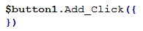
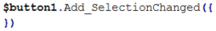
Controls and actions ?
Action is done on a control, like button, RadioButton…
A control is mapped to an action through the x:Name attribute
Action on a button is done using the event below
Event: Add_Click on the button name
Modification on a button like ComboBox, CheckBox can be done using the event below
Event: Add_SelectionChanged

Slide 23
Hide or Display Controls
You can display or hide really easily a control or a group of controls
To do that, use the Visibility attribute
The Visibility attribute contains three values
Visible: To display the control
Hidden: To hide a control
Collpased: To hide a control
Differences between Hidden and Collapsed
Hidden: keep space between controls
Collapsed: hides space

Slide 24
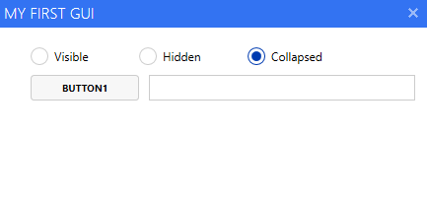
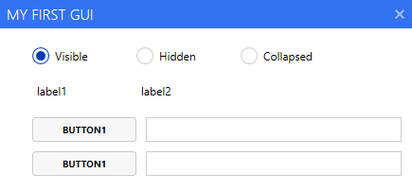
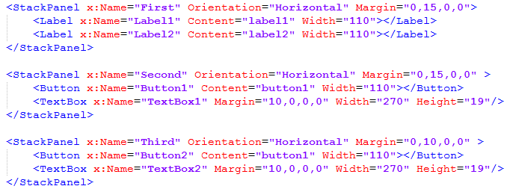
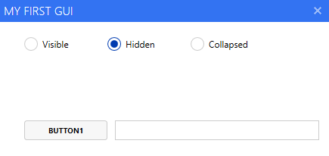
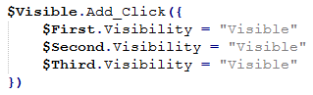
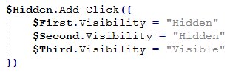
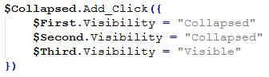
Hide or Display in action
To display one control, use the Visibility attribute on the control
To hide multiple controls, us the Visibility attribute on a StackPanel

Slide 25
Add a theme to our GUI
Not really a theme, it’s toolkit
Give a better look to your GUI
Many documentations on the web
We will see Elysium et MahApps

Slide 26
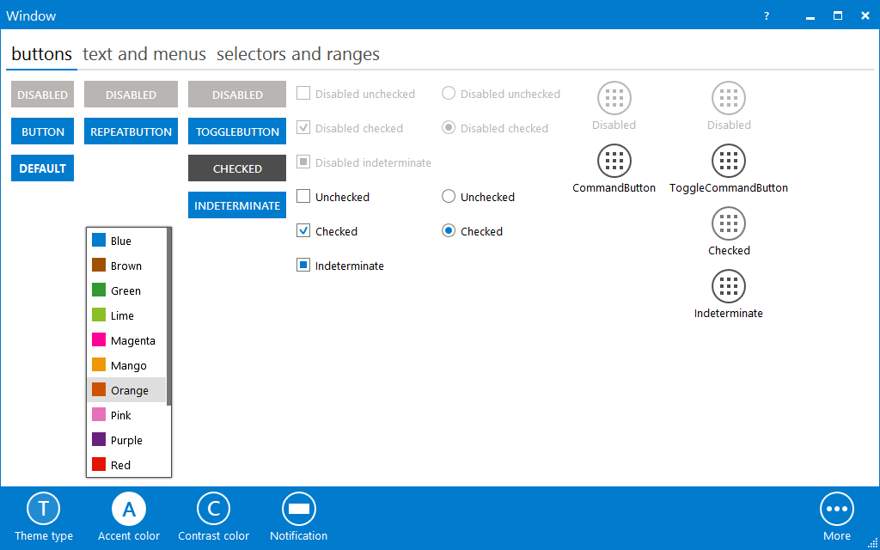
What is Elysium ?
Created by Aleksandr Vishnyakov
Website: http://elysium.asvishnyakov.com/en/
Download link : http://elysium.asvishnyakov.com/en/downloads#header

Slide 27
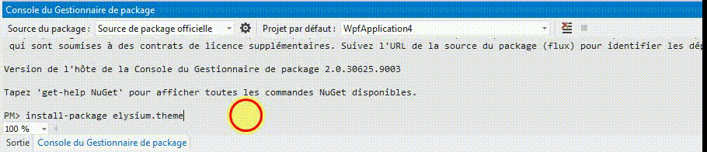
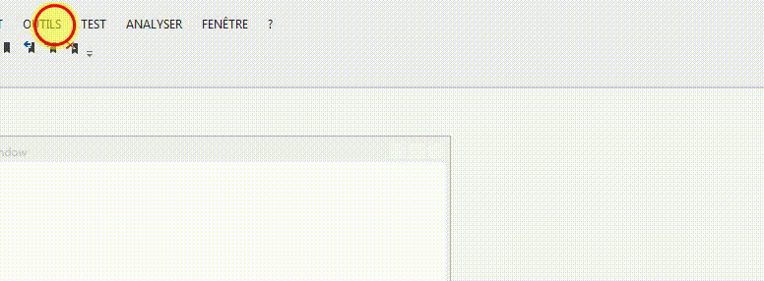
Install Elysium in Visual Studio
Go to the NuGet package manager
Elysium Installation ➔ Install-package Elysium.Theme

Slide 28
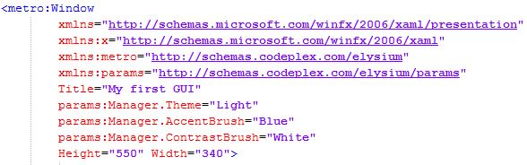
Add Elysium to an XAML
Replace the first and last Window tag with metro:Window
Add the two lines below, in the metro:Window part
xmlns:metro=http://schemas.codeplex.com/Elysium
xmlns:params=http://schemas.codeplex.com/elysium/params
Add the lines below to manage theme and colors
params:Manager.Theme="Light"
params:Manager.AccentBrush="Blue"
params:Manager.ContrastBrush="White"

Slide 29
Add Elysium to a PS1
Load the Elyisum DLL files using line below
[void][System.Reflection.Assembly]::LoadFrom("assembly\Elysium.dll")

Slide 30
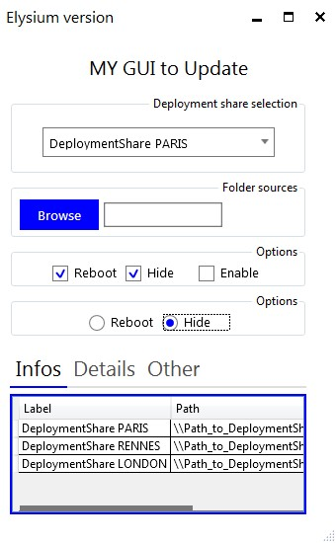
Add Elysium to our first GUI interface
We’ll first have to add lines mentioned before in XAML and PS1 files
If needed, we will have to modify Controls size

Slide 31
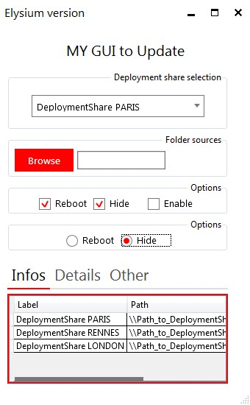
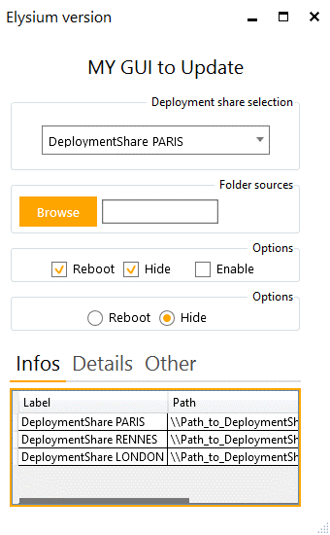
Need a new color ?
Let’s modify the Controls color in just One click ☺
Modify the line: Cobalt > Red > Orange
params:Manager.AccentBrush="Blue" > Red > Orange

Slide 32
What is Mahapps ?
Created by Paul Jenkins
Maintained by Jan Karger (MVP) ➔ https://github.com/punker76
Many updates on GitHub ➔ last 15/10/17
Web Site : http://mahapps.com/
GitHub repository ➔ https://github.com/MahApps/MahApps.Metro
Downloaded 1 million de fois

Slide 33
WPF GUI Metro Design

Slide 34
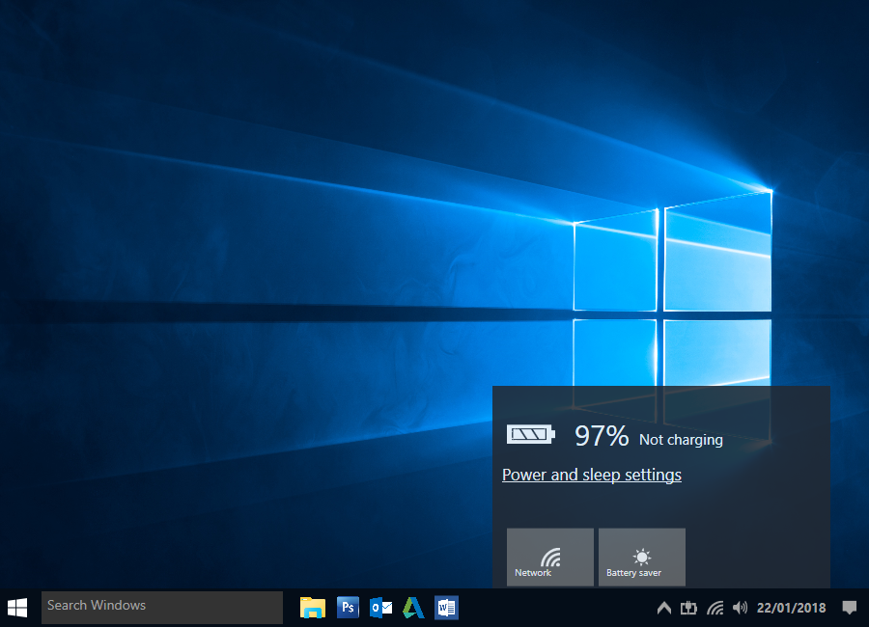







Add Metro design in few clicks

Slide 35

Install Mahapps from Visual Studio
Go to the NuGet package manager
Install ➔ Install-package Mahapps.metro

Slide 36

Get the DLL files
In order to use MahApps in our project
Build the project
Get the DLL from the Build folder
MahApps.Metro.dll
System.Windows.Interactivity.dll
Get last DLL when MahApps is updated

Slide 37

Integrate Mahapps in the XAML
Replace the 1st and last Window Tag with Controls:MetroWindow
Add the line below in the Controls:MetroWindow part
xmlns:Controls="clr-namespace:MahApps.Metro.Controls;assembly=MahApps.Metro"
The Controls:MetroWindow part will look like below

Slide 38

Add resources
Allows you to add for instance icons
Possibility to change the main theme
Possibility to change the Controls color

Slide 39
Integrate Mahapps in the PS1
Load the DLL’s from MahApps using the line below:
[System.Reflection.Assembly]::LoadFrom('assembly\MahApps.Metro.dll')

Slide 40

Add Mahapps to our first GUI
We’ll first have to add lines mentioned before in XAML and PS1 files
If needed, we will have to modify Controls size

Slide 41


Need a new color ?
Let’s modify the Controls color in just One click ☺
Ligne to modify: Cobalt > Red > Orange
<ResourceDictionary Source="pack://application:,,,/MahApps.Metro;component/Styles/Accents/Cobalt.xaml"/>

Slide 42


Need a new theme ?
MahApps allows you to change the main theme of the GUI: BaseLight, BaseDark
Line to modify: BaseLight > BaseDark
<ResourceDictionary Source="pack://application:,,,/MahApps.Metro;component/Styles/Accents/BaseLight.xaml" />

Slide 43






TabControl with WPF
Navigation Control
Not exclusive to Mahapps

Slide 44



Mahapps and Badges
Information control
Can be applied on tabItem, button…
Can be displayed where you want on the control
Allows you to display for instance:
Error nb in the event logs from a specific delay
Number of missing drivers
…
https://dev4sys.blogspot.com/2017/07/find-missing-driver-or-disabled-device.html

Slide 45









How to use Badges ?
Modify value, color and location

Slide 46


Mahapps and the Flyout
Flyout ? What is it ?
Metro Windows 10 Design

Slide 47



How to use the Flyout ?
Control to activate from a button
Add the part below in the XAML
Action in the PS1 to open the Flyout (Open or Close)
Can be displayed at the top, bottom, left, right

Slide 48





Add a Flyout in our GUI
Let us add a Flyout in our testing GUI
Can be displayed wherever you want

Slide 49


Mahapps II: Tiles Control
Tiles ? What is it ? Tiles Windows 8/10
Metro Windows 8/10 design
Actions on Tiles, like for button

Slide 50

Creation of a GUI with Tiles

Slide 51


















Different Tiles
Background color modification
Add an icon
Add a picture as background
Modify the tile size

Slide 52



Mahapps and Dialogs
To replace your msgbox
Metro Windows 10 design
Simple message
Confirmation screen
Login screen
More informations: https://dev4sys.blogspot.com/2017/07/using-mahapps-built-in-dialogs-with.html

Slide 53



How to use Dialogs ?
Get the latest DLL’s files
Simple Dialog
Dialog confirmation
Dialog Login

Slide 54
Edit your XAML with KaXAML
Cool free editor to manage your XAML GUI
https://github.com/punker76/kaxaml
See this video from J.Bezet Torres
https://youtu.be/jjSXoplwy9k

Slide 55
PowerShell to Mahapps upgrader
Apply easily MahApps to your WPF GUI
Must contain at least one PS1 and one XAML file
Download link: https://gallery.technet.microsoft.com/Powershell-to-Mahapps-fb2f50f1

Slide 56

How does the tool work ?
Select the main project folder
Select the XAML to update
Select the PS1 to update
Select the theme to apply: BaseLight ou Dark
Select the color to apply to controls

Slide 57
More detailed Posts
How to quickly build a GUI ?
Lien: http://www.systanddeploy.com/2015/10/powershell-tool-how-to-quickly-build.html
Add the Elysium theme to a GUI
Lien: http://www.systanddeploy.com/2015/10/powershell-add-theme-to-your-gui-with.html
Add the MahApps them to a GUI
Lien: http://www.systanddeploy.com/2016/01/powershell-gui-add-mahapps-metro-theme.html
Create a GUI with tiles
Lien: http://www.systanddeploy.com/2016/01/create-metro-gui-with-tiles-and.html

Slide 58
Big up to my mate
How to create a WPF GUI ?
Lien: https://dev4sys.blogspot.com/2016/05/powershell-wpf-part-i-how-to-create-gui.html
Apply a theme
Lien: https://dev4sys.blogspot.com/2016/05/powershell-wpf-part-ii-how-to-apply.html
Manage event
Lien: https://dev4sys.blogspot.com/2016/08/powershellwpf-part-iv-how-to-manage.html
Control: Dialogs
Dialogs: https://dev4sys.blogspot.com/2017/07/using-mahapps-built-in-dialogs-with.html
HamburgerMenu: https://dev4sys.blogspot.com/2017/07/mahappsmetro-hamburgermenu-powershell.html

Slide 59
More links
FoxDeploy (Stephen Owen): Learning GUI Toolmaking Series
Link: https://foxdeploy.com/series/learning-gui-toolmaking-series/
Boe Prox: Building Your First UI Using PowerShell and WPF
Link: https://mcpmag.com/articles/2016/04/28/building-ui-using-powershell.aspx
Mahesh Chand: WPF Layout System: An Introduction
Link: http://www.c-sharpcorner.com/UploadFile/mahesh/wpf-layout-system-an-introduction396/
Trevor Jones;: Good stuff about WPF and Deployment
Link: https://smsagent.wordpress.com/

